Slide 1
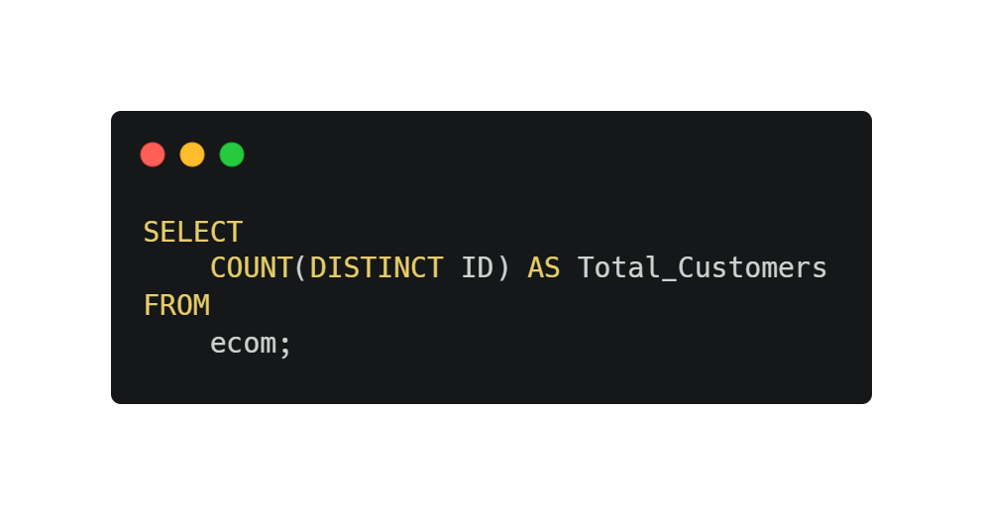

What is the total number of records in dataset?
01

Slide 2
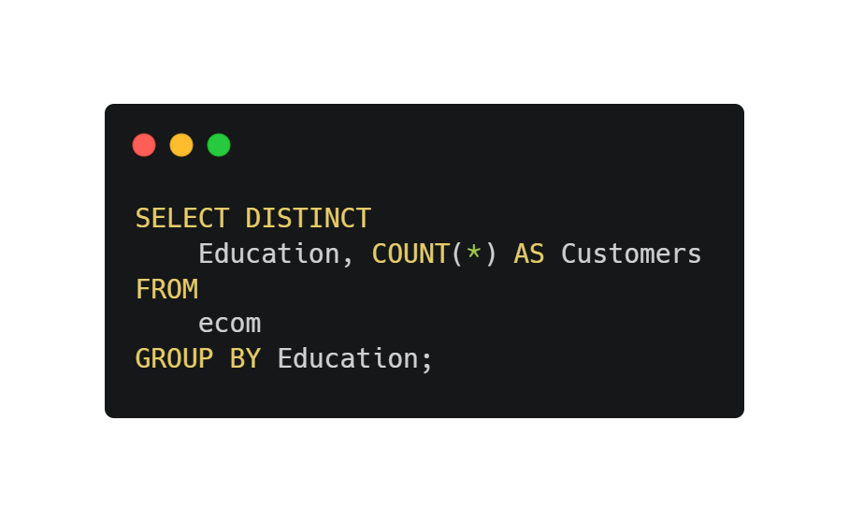
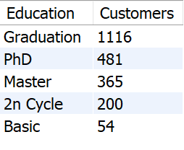
List unique education levels present in the dataset.
02

Slide 3
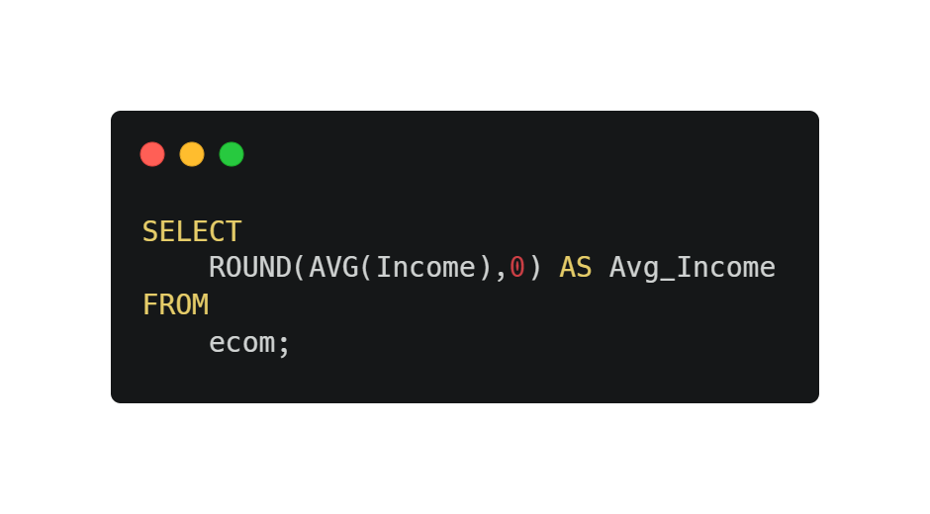

Calculate the average income of customers.
03

Slide 4
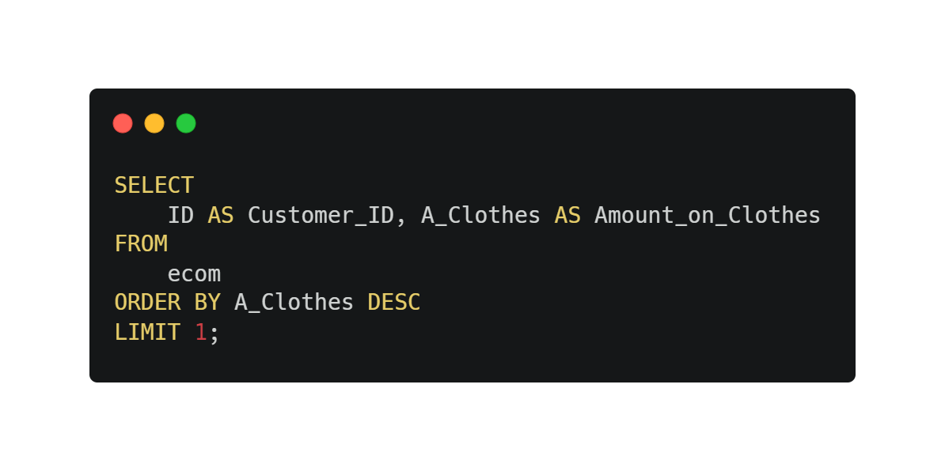

Find the customer with the highest amount spent on clothes.
04

Slide 5
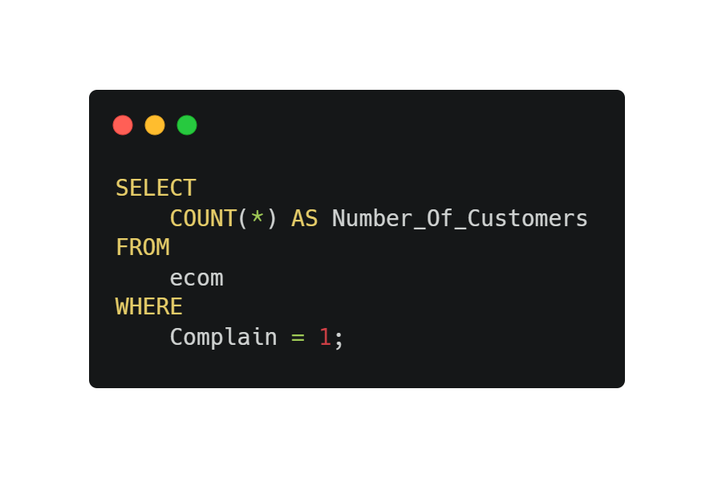

Count the number of customers who made a complaint.
05

Slide 6
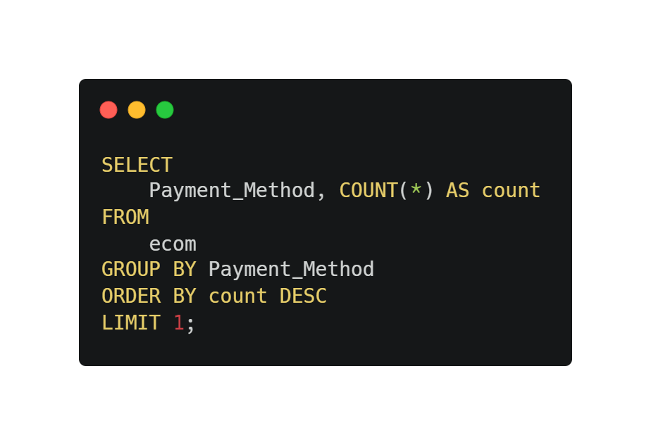

Identify the most common payment method used by customers.
06

Slide 7
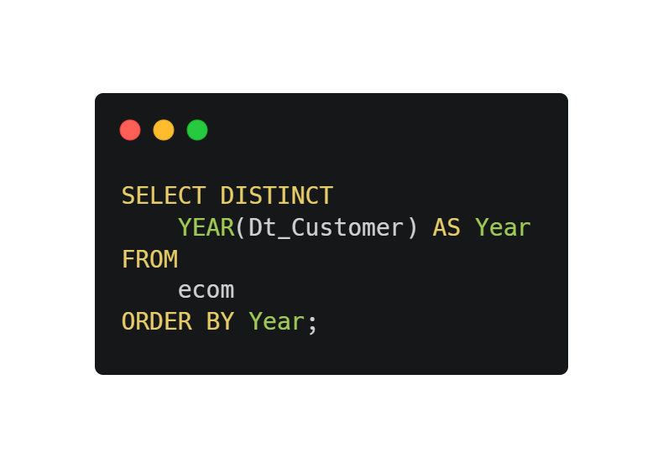

List the unique years of customer enrollment.
07

Slide 8
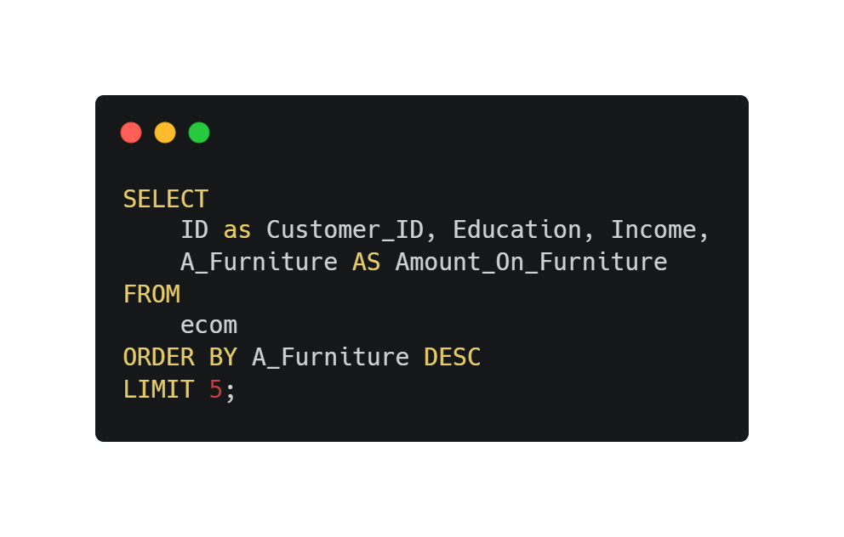
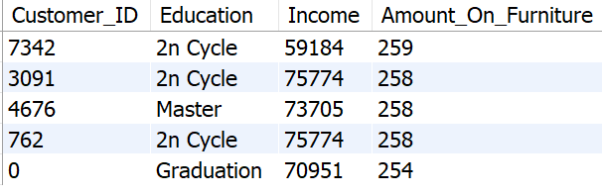
Retrieve the customer ID, education level, and income of top 5 customers who spent the most on furniture.
08

Slide 9
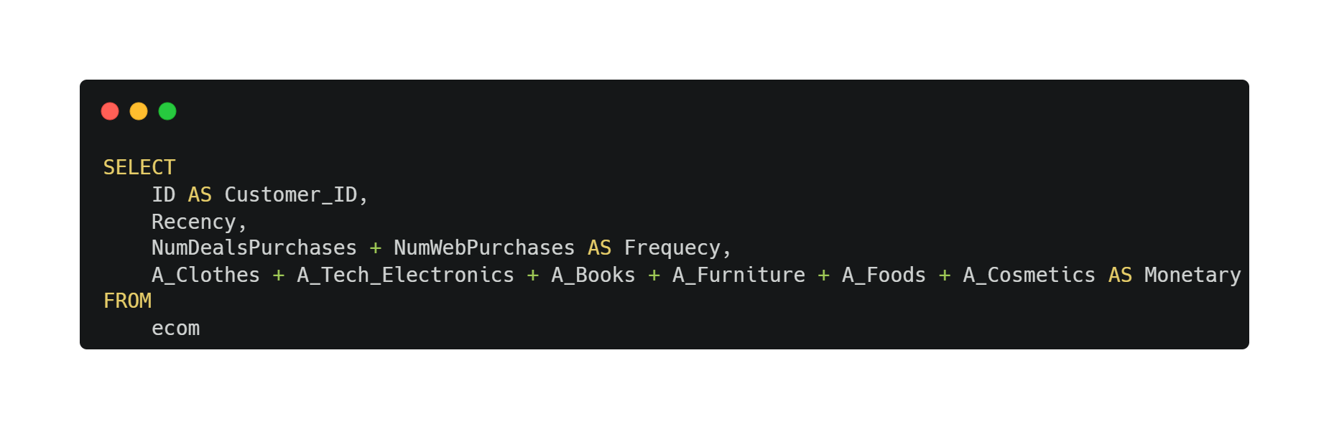
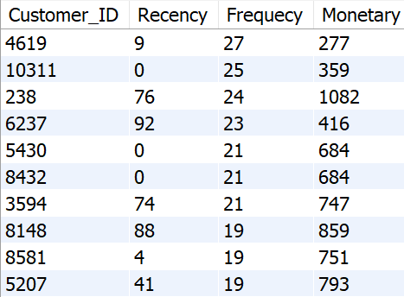
Calculate the Recency,Frequency, and Monetary values for each customer (RFM analysis).
09

Slide 10
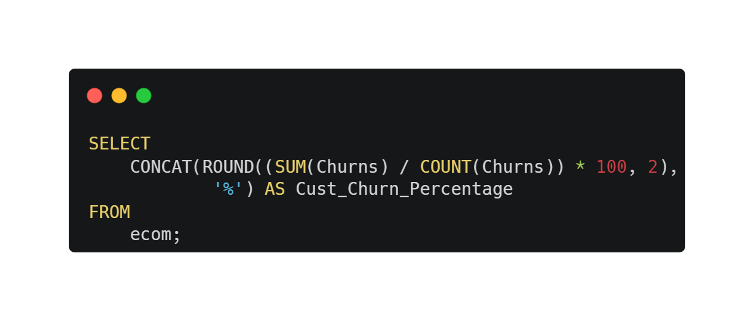

Determine the percentage of customers who have churned.
10

Slide 11
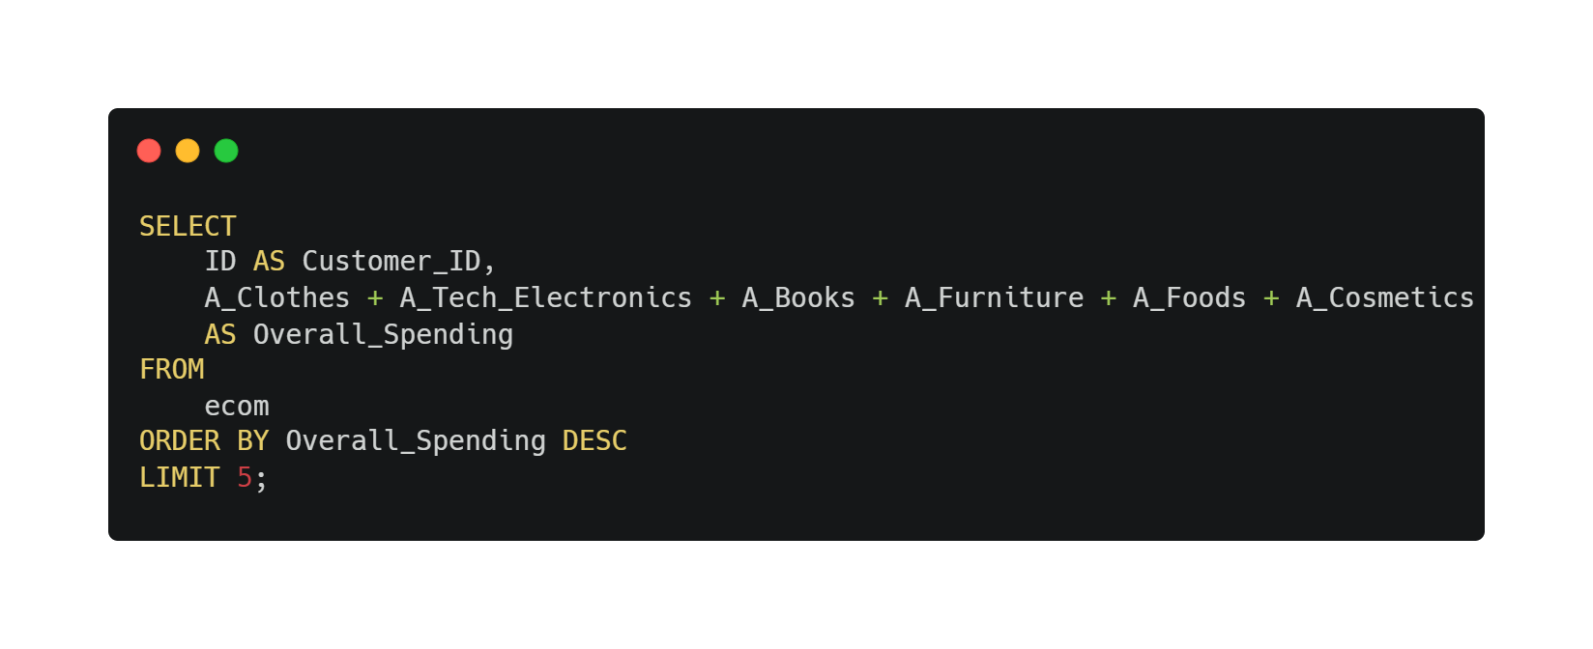
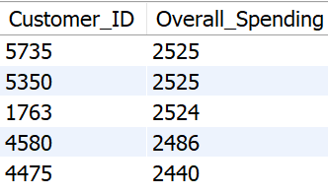
Retrieve the top 5 customers with the highest overall spending.
11

Slide 12
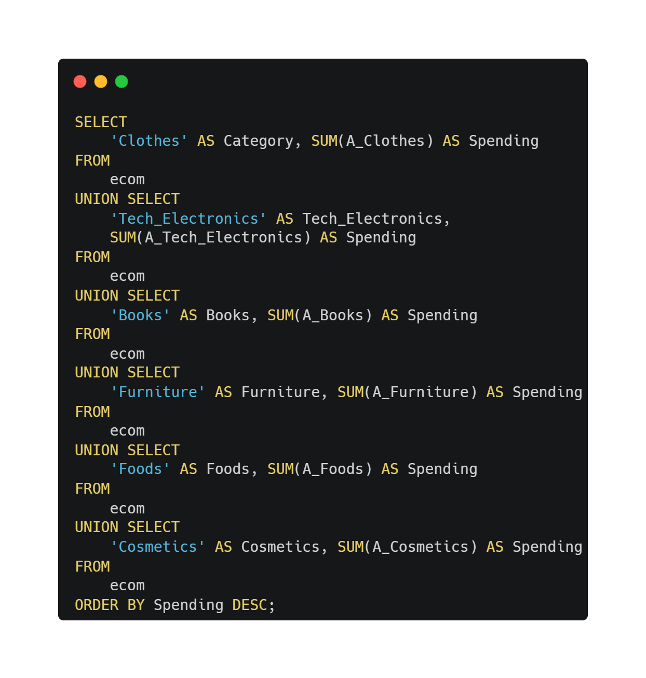
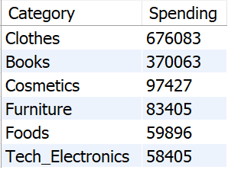
Identify the most popular category (highest total spending) among customers.
12

Slide 13
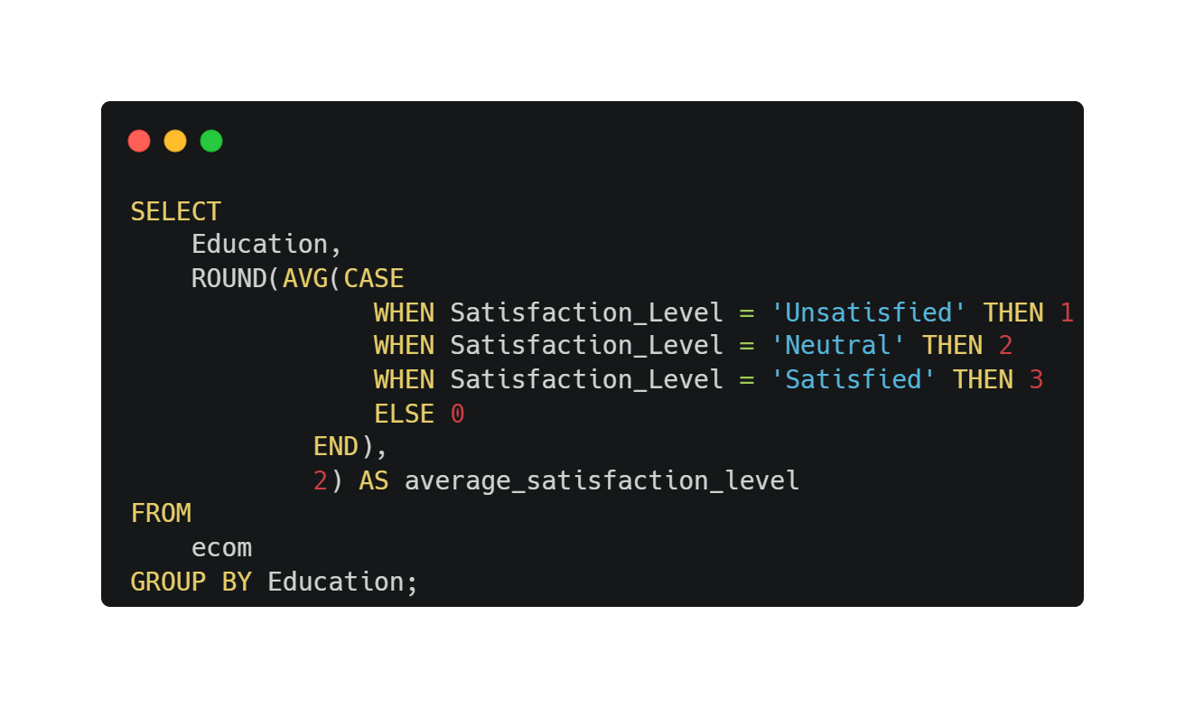
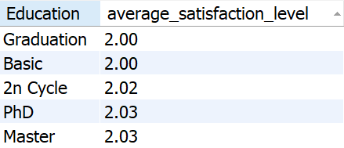
Calculate the average satisfaction level for each education level.
13

Slide 14
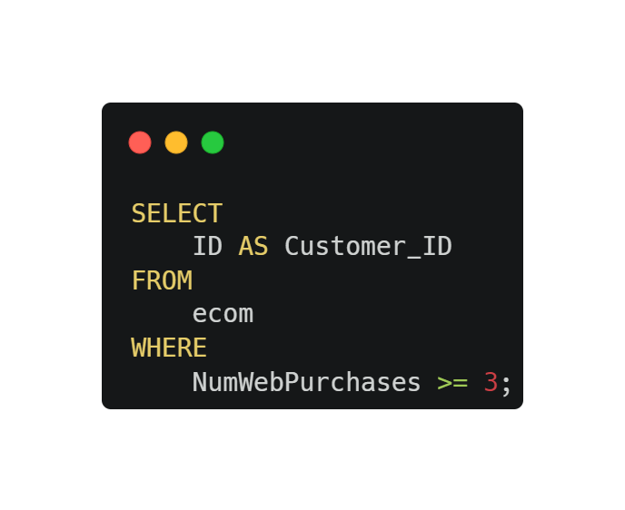
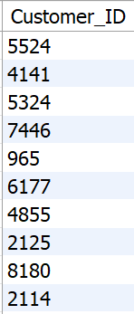
List customers who made purchases on more than three websites
14

Slide 15
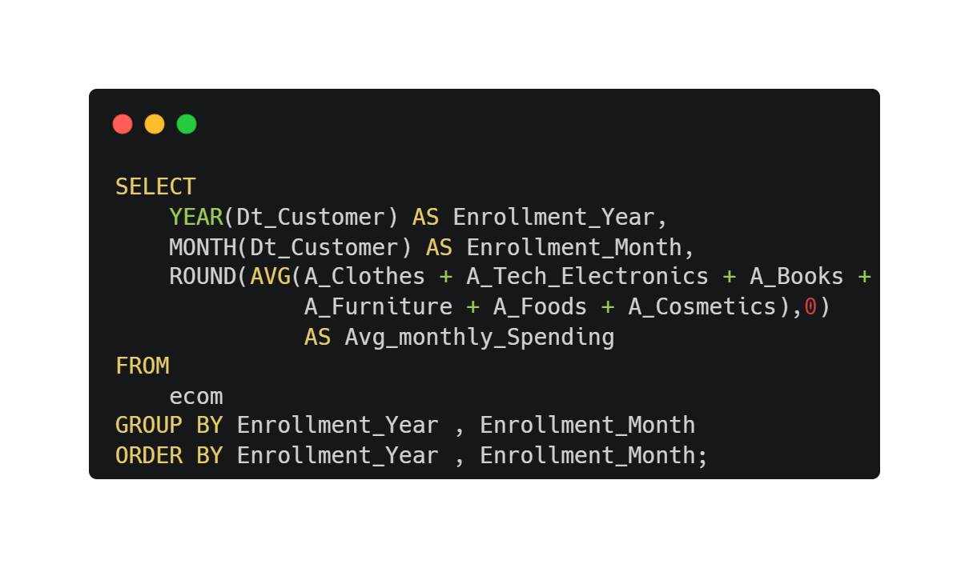
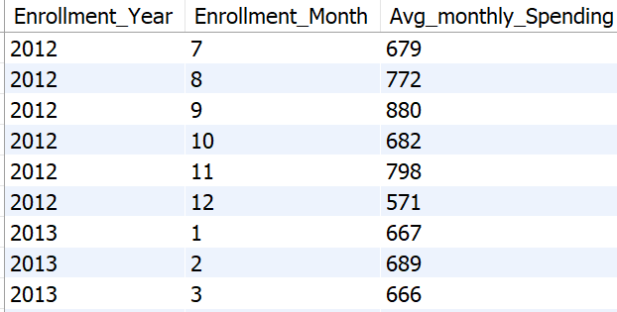
Perform a cohort analysis based on the year of customer enrollment.
15

Slide 16
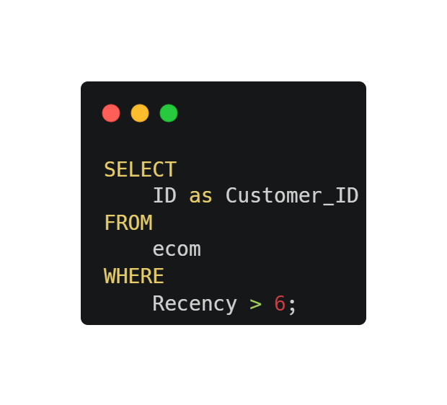
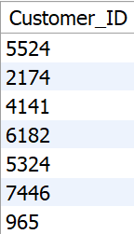
Identify customers who have not made any purchases in the last six months.
16

Slide 17
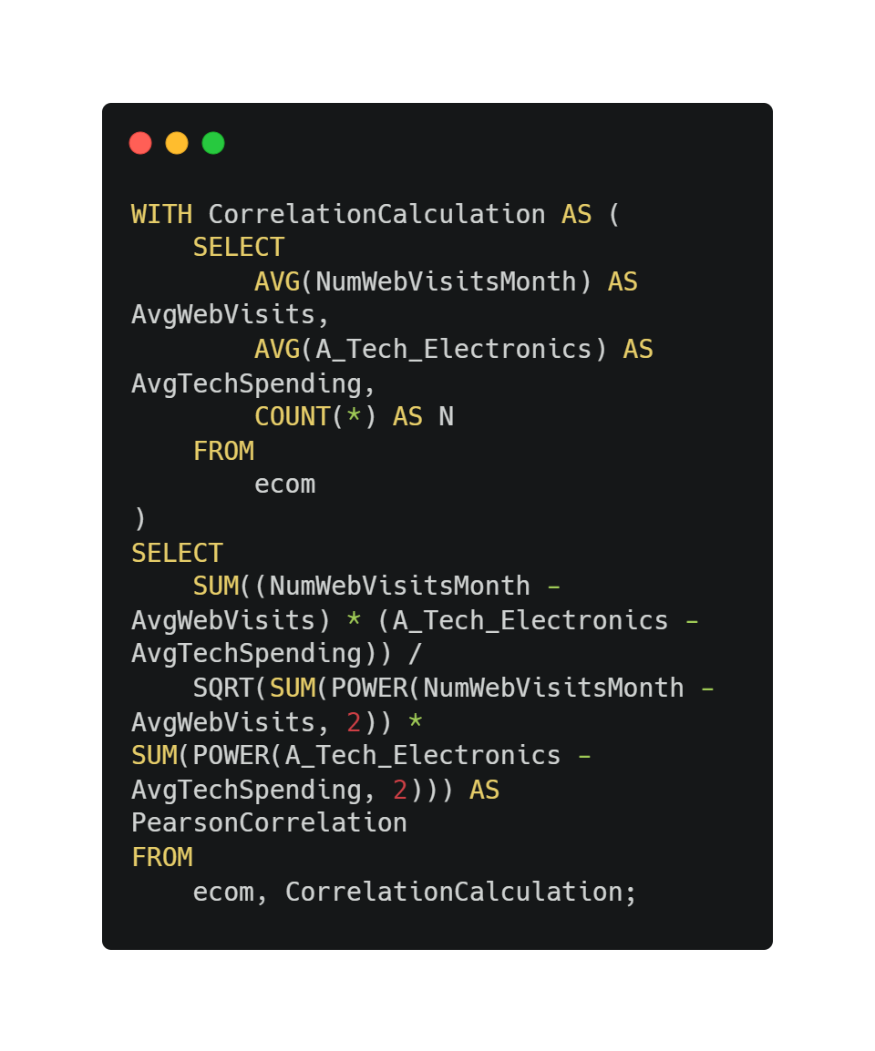
Determine the correlation between the number of web visits and the amount spent on technology.
1

Slide 18
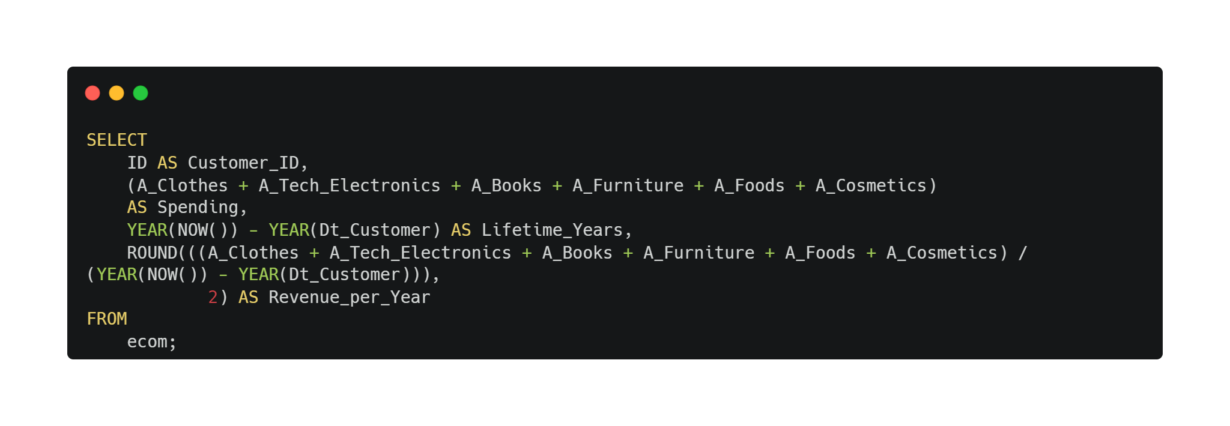
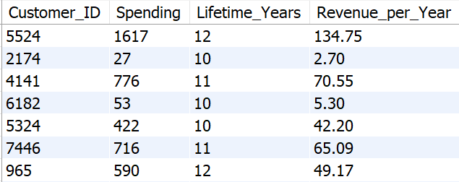
Implement a query to calculate the Customer Lifetime Value (CLV) for each customer.
18

